Slide 1
DRL Agent For Car Racing Game
Qidi Fang, Tian Huang, JIajin Huo

Slide 2
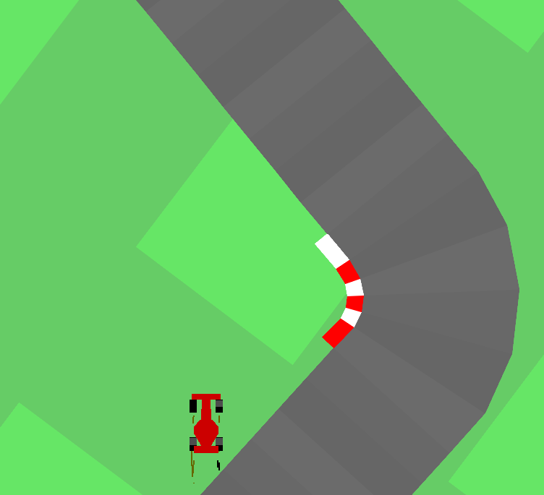
what problem did we solve?
- Applied DRL in Car Racing Game
- Gym Box2D - Car Racing
- Compared the performances and time costs of Double Deep Q-Network (Double DQN) , Actor-Critic(AC) and Preferred provider organization(PPO)
Target of the game:
Keep on track
Notes:
So, what problem did we solve? We planned to apply Deep Reinforcement Learning algorithms in Car Racing Game. And there weren’t many car racing games can be director used to train a DRL agent.
We finally found OpenAI gym car racing games as is shown in the left figure
The primary target for the AI agent was to stay on track throughout the race.
And we trained and compared the performances and time costs of Double Deep Q-Network (Double DQN) , Actor-Critic(AC) and Preferred provider organization(PPO)

Slide 3
Related Work
Car Racing Game:
Asynchronous Advantage Actor Critic(A3C) Jaritz et al.
Soft-Actor-Critic(SAC) https://github.com/trackmania-rl/tmrl
Combined state-of-the-art, model-free, deep reinforcement learning algorithms in Gran Turismo, Wurman PR et al.
OpenAI gym Car Racing:
PPO https://notanymike.github.io/Solving-CarRacing/
DQN https://github.com/andywu0913/OpenAI-GYM-CarRacing-DQN
PID https://medium.com/@kartha.kishan/solving-openai-carracing-v0-using-image-processing-5e1005ee0cb
Notes:
These are some implementation that have be done on other car racing games and our OPenAI gym car racing environment.

Slide 4
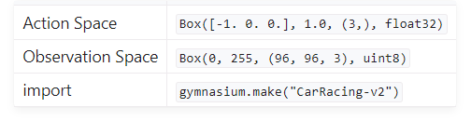
Environment
Action Space & State Space
Reward Function
The reward is -0.1 every frame and +1000/N for every track tile visited, where N is the total number of tiles visited in the track. For example, if you have finished in 732 frames, your reward is 1000 - 0.1*732 = 926.8 points.
Notes:
This is the environment for a car racing game.
Firstly, the action space is a 3-dimensional vector. dimension 1 is steer left or right, 2 is gas, 3 is brake.
The state space is a 96x96x3 RGB image, which represents the entire game interface."

Slide 5
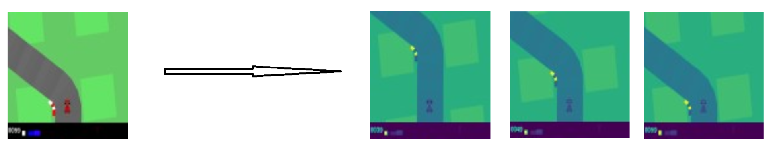
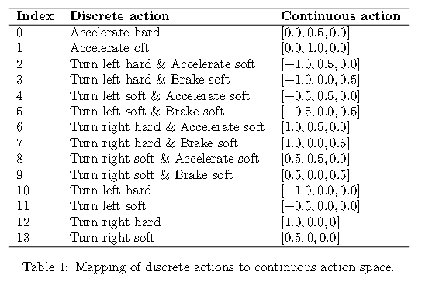

Wrapped Environment
State Space
Action Space
Reward Function

Slide 6
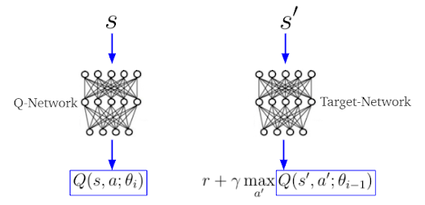
Double DQN

Slide 7
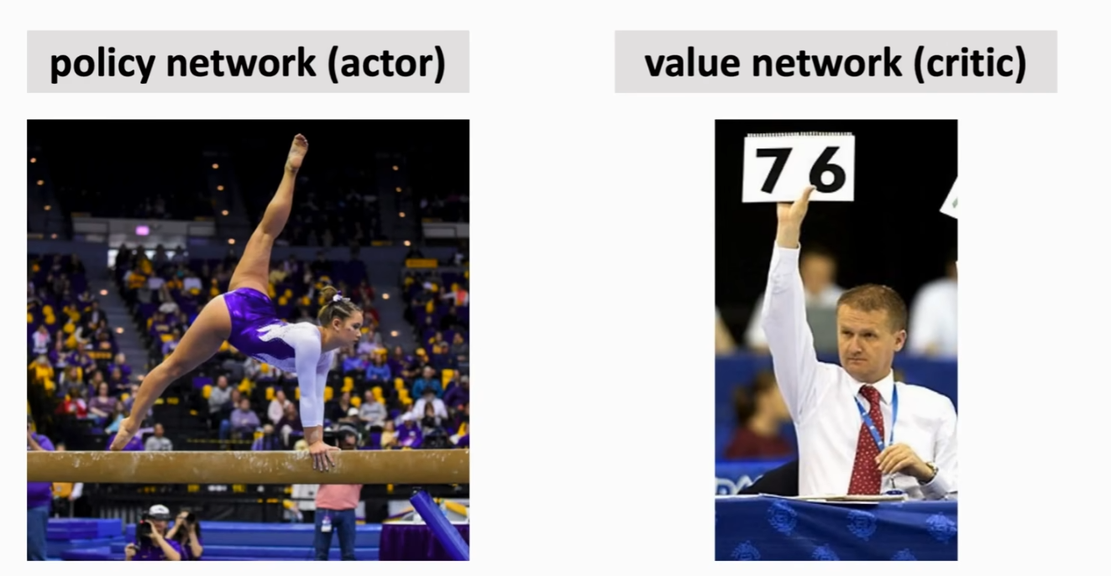
Actor-Critic Algorithm
https://www.youtube.com/watch?v=vmkRMvhCW5c&list=PLvOO0btloRnsiqM72G4Uid0UWljikENlU&index=2&t=876s
Notes:
As the AC algorithms have been mentioned in the sutton and barto textbook. Let’s quickly review the Actor-critic algorithm. This algorithm can be divided into two crucial components:
1.the actor, responsible for making decisions and executing actions,
2.and the critic, which is in charge of scoring.
3.The actor selects actions and observes the critic's scores to improve its strategy. Meanwhile, the critic not only continually assigns scores but also progressively refines the accuracy of its scoring.

Slide 8
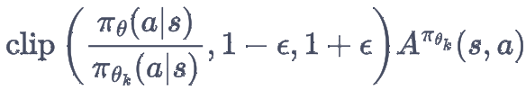
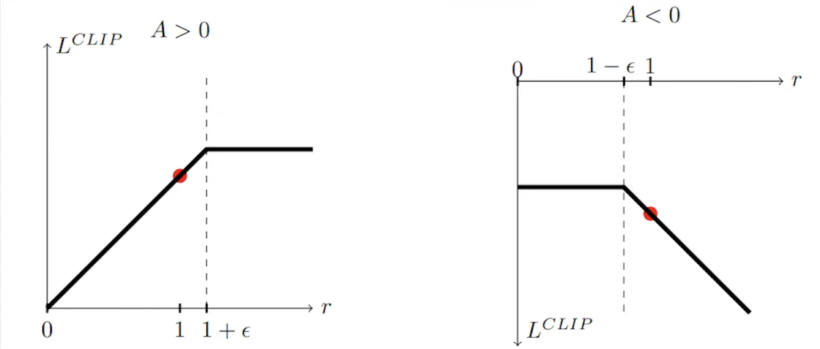
PPO-Clip Algorithm
figure 1
figure 2

Slide 9
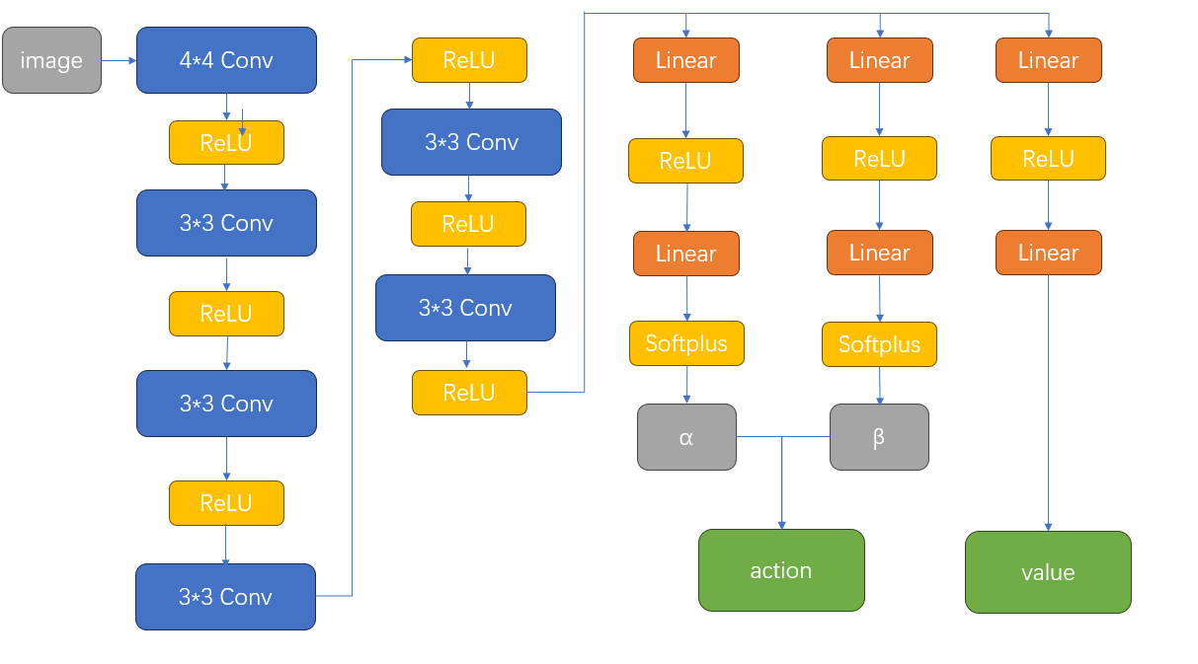
Experiments
Hyper Parameter:
actor_lr = 1e-3
critic_lr = 1e-3
gamma = 0.98
epsilon = 0.1
batch_size = 64
buffer = 10000
target_update = 10/10000 steps
https://github.com/NoahF1205/CS138-Final-Project
Notes:
there is the setting of experiments. the figure left is the network structure.
and we employed cnn to distract features from the picture. and we use fully connected layer to get our action value and final policy.
the hyper parameter is a generous setting is for the condition control of the performance comparison.

Slide 10
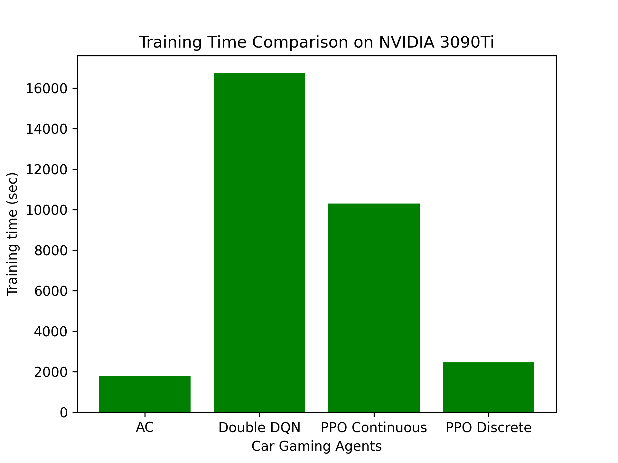
Result 1: Training Time

Slide 11
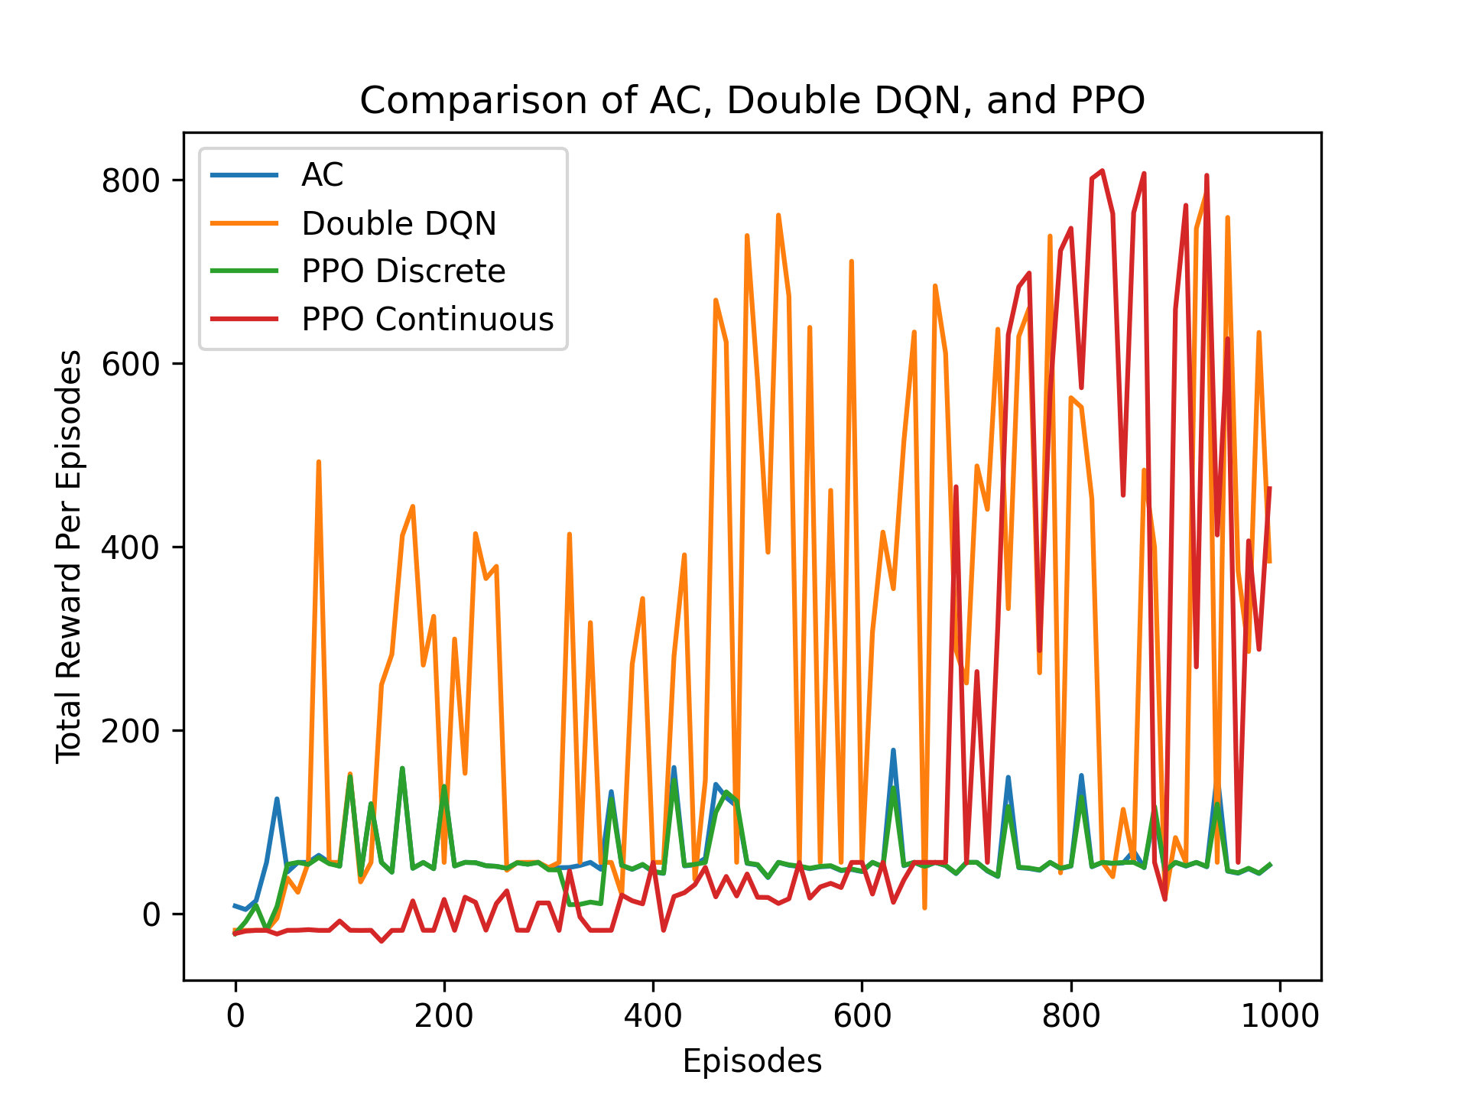
Result 2: Total reward per episode

Slide 12
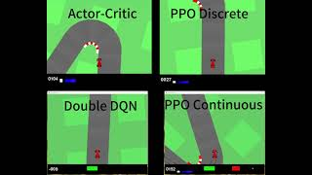
Agent Performance

